Slide 1
ANALYSIS OF CAFÉ HARMONY
By Opeyemi Olaniran

Slide 2
outline
Introduction
Objectives
Data Overview
Key insights
Recommendations

Slide 3
introduction
The café specializes in offering a variety of drinks, snacks, and light meals to customers.
Over the past year, Café Harmony has seen impressive growth but now faces new challenges as the company is scaling to meet customer demand.
The café has multiple locations across the city, each with its own performance metrics and unique customer preferences.

Slide 4
Objectives
The goal of this project is to identify the following business questions :
Which menu items are performing the best across different locations?
What is the customer profile that tends to spend the most (age, gender, or preferred product)?
How can the café improve its stock management to avoid running out of popular items while also reducing overstock?
Are there any locations or employee performance issues that require attention

Slide 5
Data overview
The multiple datasets used are the Sales data, the employee data, the customer data, stock data and the feedback data.
The datasets were cleaned and checked for duplicates, blanks and errors before they were analysed

Slide 6
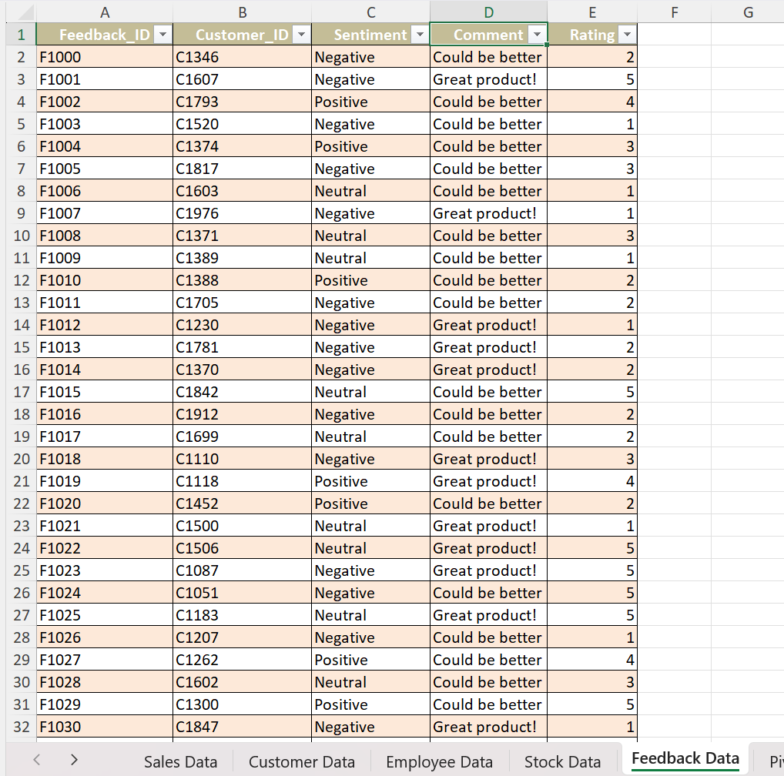
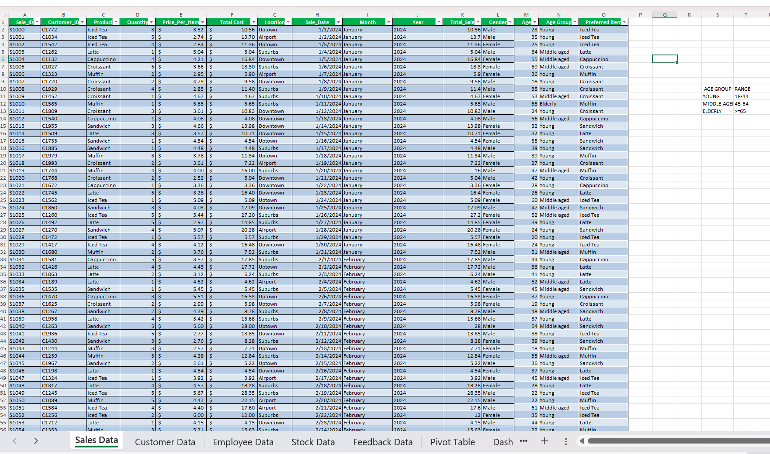
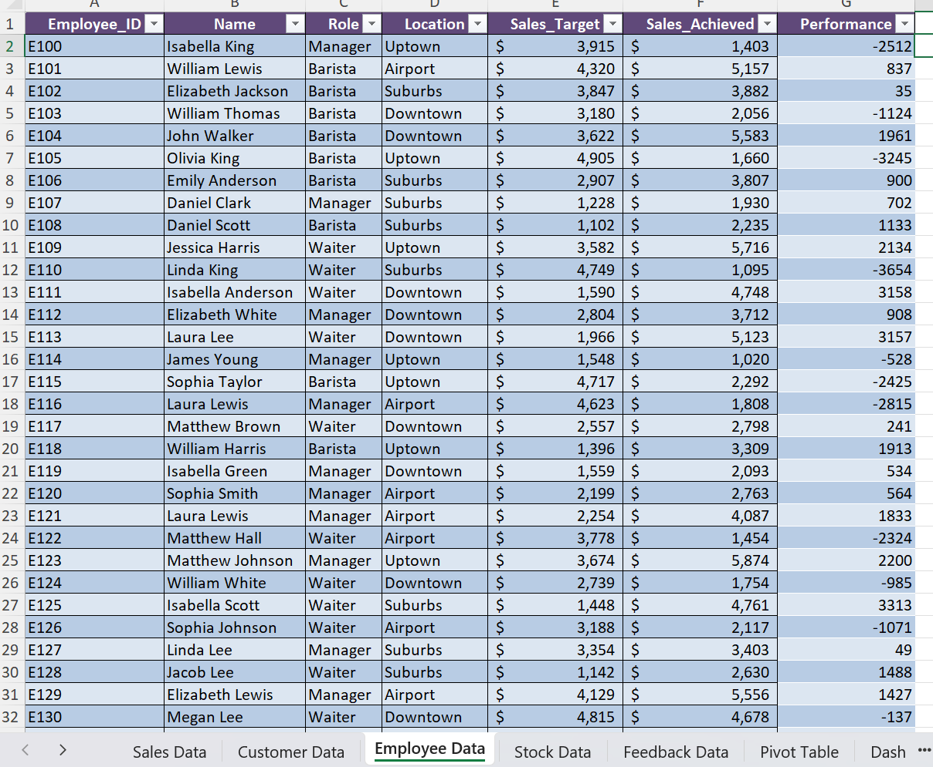
Data overview

Slide 7
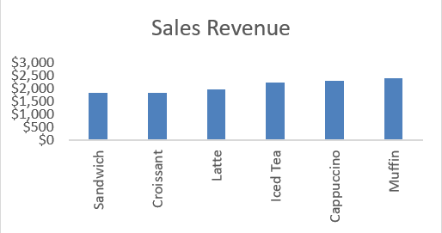
KEY INSIGHTS
Menu Performance
Q1. Which top-selling menu product generate the most revenue?
Muffin was the top-selling menu product, generating approximately $2,400 overall across all locations. However, Muffin had the highest sales at two locations; the Airport and Uptown, generating about $1,355. Sandwich was the least-selling product.

Slide 8
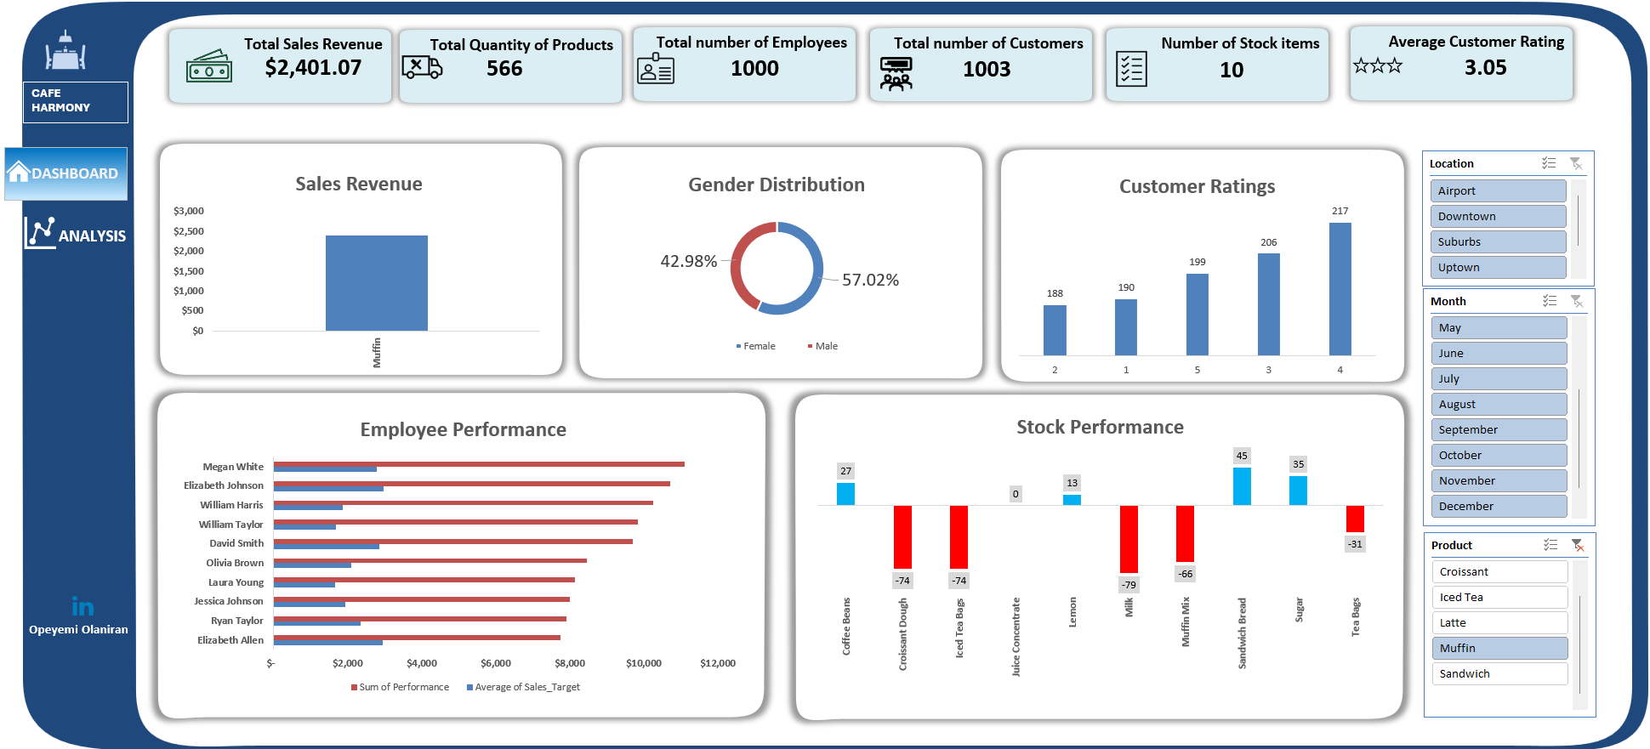
Total sales revenue generated from muffin

Slide 9
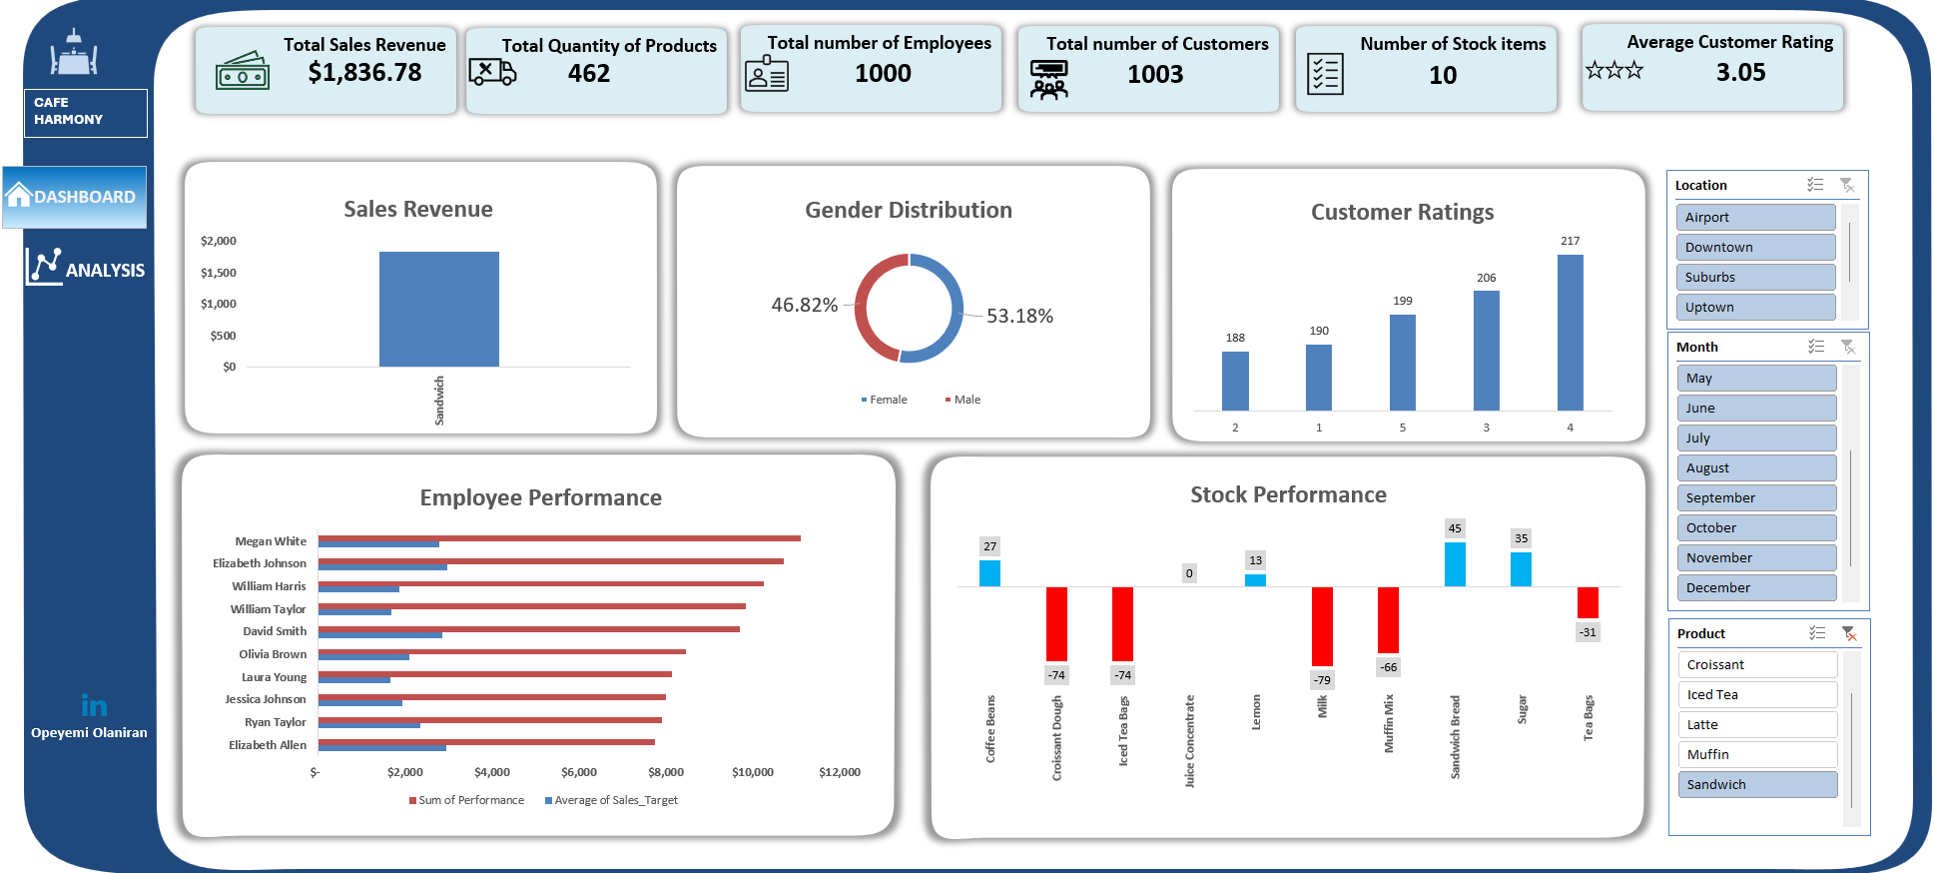
total sales revenue generated from sandwich

Slide 10
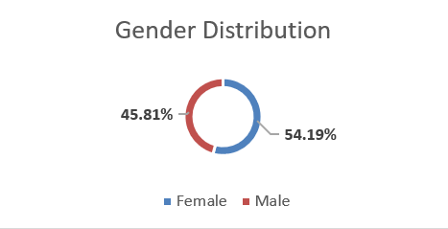
KEY INSIGHTS
Customer Spending
Q2. Which customer demographic (age, gender, or preferred items) is driving the highest sales?
Female customers contributed about 54.19% of the total revenue generated. However, the male customers contributed about 52% of the sales revenue generated from Latte.

Slide 11
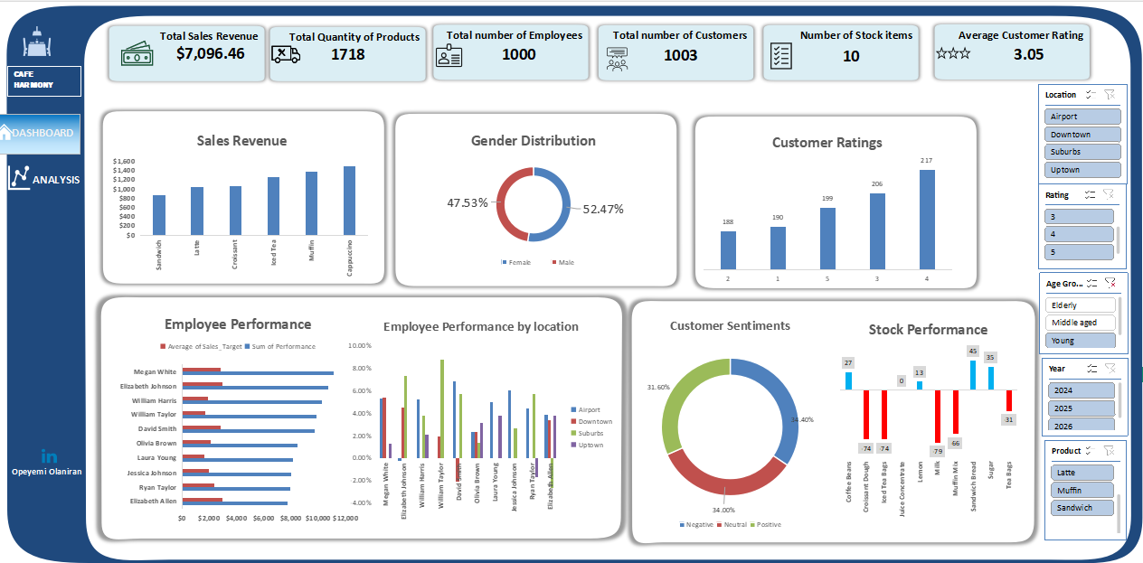
KEY INSIGHTS
Customer Spending
The young (18–44-year-old)accounts for most of the total sales revenue generated, about $7,096; with 52.47% of them being females.

Slide 12
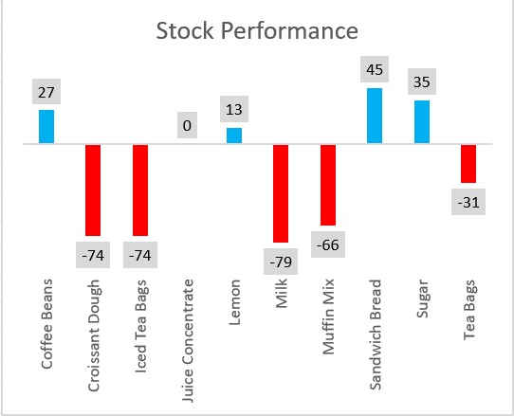
KEY INSIGHTS
Stock Management
Q3. Which ingredients or products are most commonly running low across locations?
The juice concentrate is adequately stored while the coffee beans, lemon, sandwich bread and sugar are overstocked.
The products which are frequently running low are Milk, Iced Tea bags, Croissant Dough, Muffin mix and Tea bags.

Slide 13
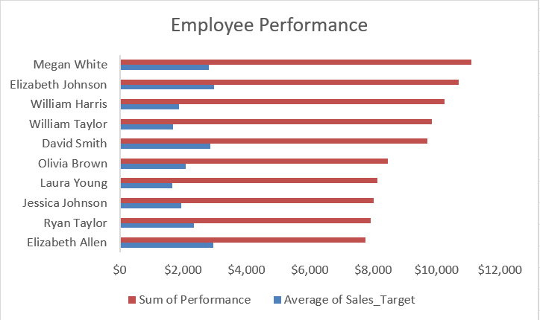

KEY INSIGHTS
Employee Performance
Q4. Which employees are performing above or below the average sales target?
The graph shows the top ten high-performing employees with Megan White achieving the highest sales; $11,095 above the sales target. The sales were more at the Airport location.

Slide 14
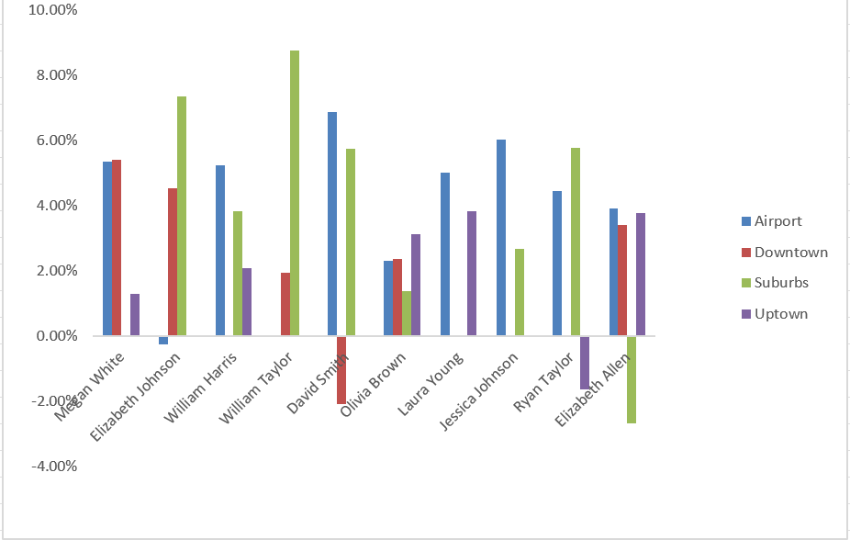
Top 10 EMPLOYEE PERFOMANCE BY LOCATION

Slide 15
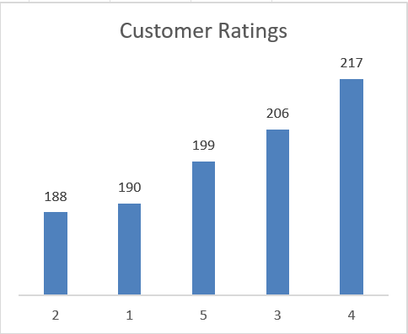
KEY INSIGHTS
Customer Feedback Analysis
Q5. Analysis of customer feedback to identify common themes in satisfaction or dissatisfaction.
217 customers rated their satisfaction as 4 while 190 customers were dissatisfied.
The average customer rating was 3.05.

Slide 16
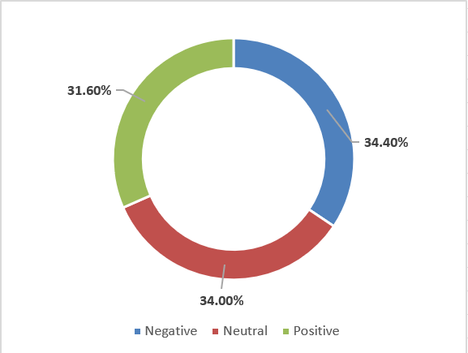
KEY INSIGHTS
Customer Feedback Analysis
34.40% reported negative sentiments, 31.60% were positive and 34% were neutral.

Slide 17
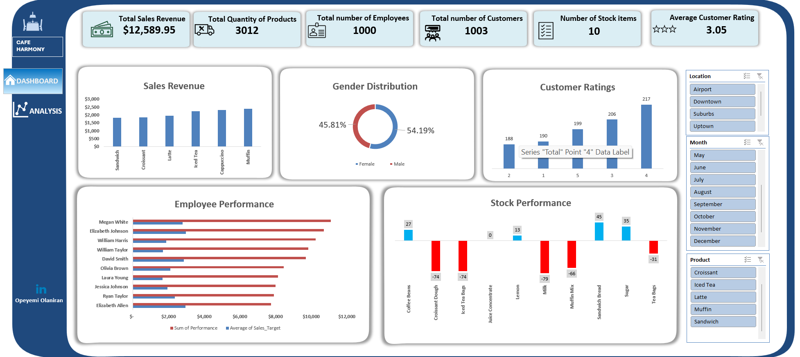
Dashboard showing various kpiS

Slide 18

recommendations
The top-selling menu is Muffin.
High-demand menu products across various locations should be focused on to avoid complexity in menu preparation.
Preparation of ingredients of top-selling menu product ahead of time to speed up service.
Meal Promotion of other products in combination with the top selling product to encourage purchase of lower-selling products.
Regular inventory of products to ensure that frequently used products are always in stock, least used ones are not overstocked

Slide 19
recommendations
To improve employee performance, employees should be periodically trained on meeting sales targets and quality assurance.
Incentive for employees like the “Employee of the month” award or rewards for meeting sales target should be considered to encourage them to improve their sales performance.
Customers feedback and complaints should be acted upon quickly via root cause analysis
Loyalty programs should be introduced to retain customers.
Marketing strategies should be focused more on female customers since they account for most of the customers.

Slide 20


Thank you

